Slide 1
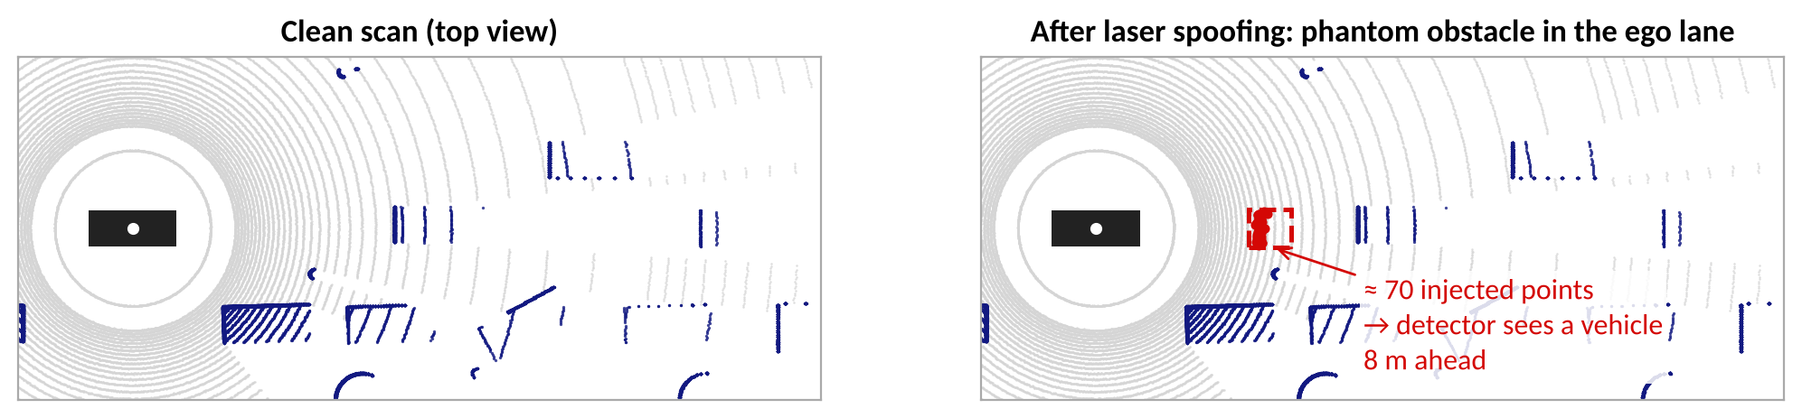
L4.2 Adversarial Attacks for AD
Zonghua Gu | Fall 2026
Based on papers from USENIX Security, CCS, CVPR, IEEE S&P and VehicleSec (see references)
Notes:
Supplement to L3.2 (about 75 minutes). L3.2 covered the algorithms (FGSM, PGD, physical attacks, adversarial training). This lecture asks what changes when the victim is an autonomous vehicle: temporal state (tracking), a different sensor (LiDAR), multi-sensor fusion, and the closed loop down to steering and braking. Timing guide: recap 8 min, tracking 12, LiDAR 22, fusion 10, closed loop 15, defenses and discussion 8. Title image: synthetic LiDAR scan with injected phantom points (original figure).

Slide 2
Outline
Recap and the AD attack surface
Attacks on object tracking
Attacks on LiDAR perception
Is sensor fusion safe?
From perception errors to driving consequences
Defenses and discussion
Notes:
Roadmap. Each part ends with what level of harm the papers actually demonstrated; we return to that distinction on the closing slides.

Slide 3
Recap: the L3.2 Toolbox
L3.2 concept | What we learned | What changes for autonomous driving
Perturbation budget | Small ℓp-norm δ keeps the input 'the same' for a human | Physics replaces the norm ball: the attack must be printable, projectable, or a placeable object
White-box gradients (FGSM, PGD) | Differentiate the loss w.r.t. the input | Pipeline stages (NMS, voxelization, tracking) are non-differentiable: need proxies or search
Physical attacks | Optimize over viewpoints, lighting, and spatial masks | Must also survive distance, motion, sensor noise, and time
Black-box transfer | Craft on a proxy model, hit the target | Open AD stacks (Apollo, Autoware, OpenPilot) are realistic white-box targets
Adversarial training | min-max training raises robustness | Costs accuracy and real-time budget; does not cover non-image attack surfaces
Recap of L3.2 (Madry et al.; Goodfellow et al.; Evtimov et al.; Nassi et al.).
Notes:
Two-minute recap, then use it as the map for the lecture. Ask students which row they expect to break first when the victim is a full driving stack.

Slide 4
The Whole Driving Loop Is the Target
Sensors
LiDAR, camera
Detection
segmentation
Fusion
Tracking
Prediction
Planning
Control
laser spoofing / removal
adversarial objects
patches, adversarial
objects
frustum attack
MSF-ADV
dynamic patches
against MOT
LiDAR-induced
false trajectories
adversarial driving
maneuvers (Acero)
dirty road patch
(lane centering)
attack entry points covered today
• Errors injected early may be filtered (a tracker smooths one bad frame) or amplified (a wrong lane center steers the car)
• The attacker chooses the weakest layer, not the one we trained adversarially in L3.2
• A fair security evaluation therefore measures the outcome at the controller, not only model accuracy
Notes:
Walk left to right. Each arrow is a place where an error can be amplified or filtered. L3.2 attacked the first two boxes with pixels; today we also attack the sensor physics, the tracker, fusion, and the controller. The coloured tags show where the papers in this lecture enter.

Slide 5
Threat Model Dimensions for AD Attacks
Dimension | Options | AD examples in this lecture
Attack channel | digital · physical sensor (laser, projector) · physical object · V2X message · driving behavior | laser spoofing; adversarial 3D-printed object; fabricated V2X features; Acero maneuvers
Attacker knowledge | white-box · gray-box · black-box | white-box on open stacks (Apollo, Autoware); black-box spoofing (Sun et al.)
Goal | hide an object (false negative) · create a phantom (false positive) · mislead class or trajectory · degrade tracking or control | vehicle hiding; phantom obstacle; wrong predicted trajectory; lane departure
Constraints | stealth · cost · physical realizability · timing (attack must be on-line) | 70 spoofed points; 0.3 m objects; patch on a road; normal-looking driving
Taxonomy adapted from L3.2 and the surveys cited in the references.
Notes:
Use this as a vocabulary slide. For every paper later, ask: channel, knowledge, goal, constraints. Note that 'physically realizable' is a property of the channel, not of the algorithm.

Slide 6
Three Levels of Attack Success
Level 1
Model-output error
A frame is misclassified, an object is missed, or a phantom appears
metric: attack success rate, mAP drop
Level 2
Persistent perception failure
The error survives tracking and fusion over many frames
metric: track loss, ID switches, duration of failure
Level 3
Closed-loop safety violation
The vehicle collides, leaves its lane, or brakes hard
metric: collision rate, time to violation, rule violations
stronger claims need more evidence: level 1 does not imply level 2, and level 2 does not imply level 3
Notes:
This slide is the lens for the whole lecture. Papers often report level 1 (success rate against a model) while the safety question lives at level 3. The tracking attack (part 2) shows level 1 does not imply level 2; Dirty Road and Acero (part 5) report level 3. Ask students to place each paper on the ladder as we go.

Slide 7
Outline
Recap and the AD attack surface
Attacks on object tracking
Attacks on LiDAR perception
Is sensor fusion safe?
From perception errors to driving consequences
Defenses and discussion
Notes:
Part 2: attacks on object tracking (about 12 minutes).

Slide 8
Detection vs. Multi-Object Tracking
Camera frames
Detector
(YOLO, ...)
Boxes per frame
Association
(Hungarian)
Kalman
predict / update
Tracks with IDs
• Planning consumes tracks (identity, velocity), not raw single-frame detections
• Each track is predicted forward with a motion model (e.g., constant velocity) and corrected by matched detections
• A track that is unmatched for more than max_age frames is deleted; new tracks are created from unmatched detections
• So the tracker acts as a temporal low-pass filter: isolated misses are bridged by prediction
• Consequence for the attacker: fooling the detector in one frame is not enough
Tracking-by-detection as in SORT/ByteTrack-style trackers; Apollo and Autoware use similar designs.
Notes:
Tracking-by-detection: each frame the detector produces boxes; the tracker predicts every existing track with a Kalman filter, associates detections to tracks (Hungarian algorithm), updates matched tracks, creates tracks for unmatched detections, and retires tracks that have not been matched for max_age frames. Key teaching point: the tracker is a temporal filter, so a one-frame detection failure is usually invisible downstream.

Slide 9
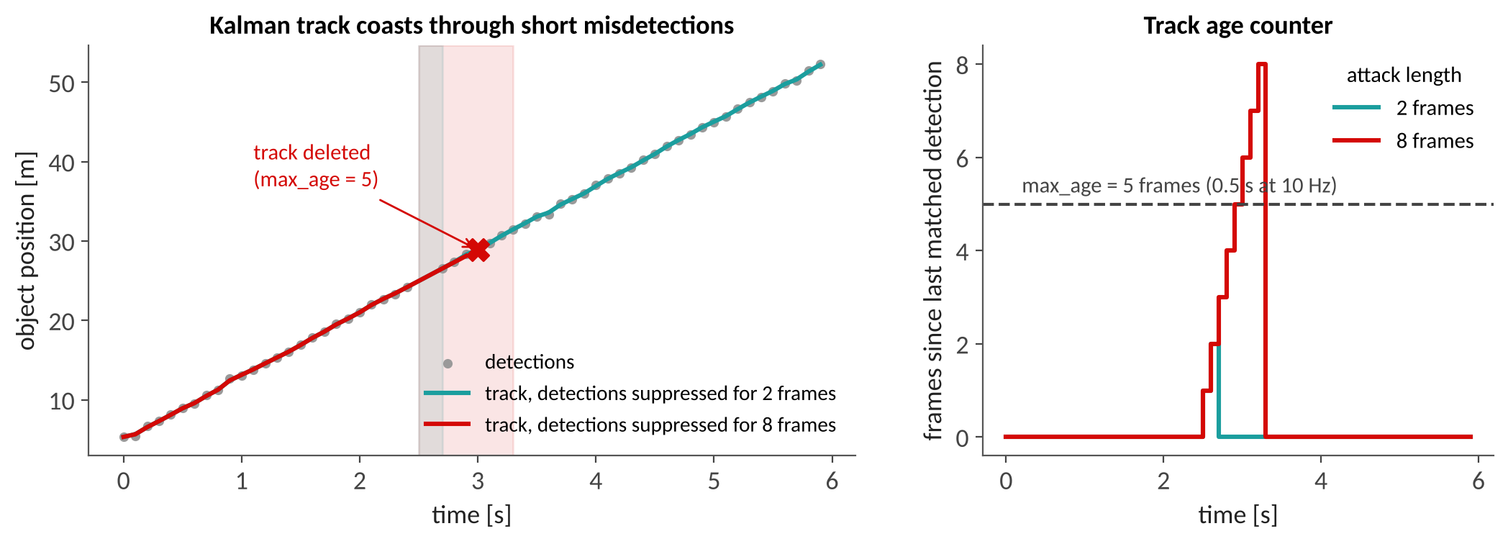
Why Tracking Changes the Attack
Toy model: constant-velocity object, Kalman tracker, 10 Hz, max_age = 5 frames. Suppressing detections for 2 frames changes nothing; 8 frames deletes the track
Real finding: detection attacks alone are often not enough: over 98 % detection-attack success may be needed to change tracking outcomes (Jia et al., ICLR 2020)
Attack design must therefore reason about association and track management, not just boxes
Original figure: toy simulation. Jia et al., Fooling Detection Alone is Not Enough, ICLR 2020.
Notes:
Run the simulation mentally: the Kalman filter predicts the position, so a short gap leaves a small error. Only when the gap exceeds max_age is the track deleted, and then a new ID appears, which downstream modules treat as a new object. Be explicit that this is our own toy simulation (illustrative), while the 98% statement is a literature finding.

Slide 10
Attacking MOT: Threat Model (WIP)
Chen Ma, Ningfei Wang, Qi Alfred Chen, Chao Shen: Towards the Practicality of the Adversarial Attack on Object Tracking in AD
Gap: prior tracking attacks target a single-object tracker (Muller et al., CCS 2022) or are digital only (Jia et al., ICLR 2020); none attacks multi-object tracking in the physical world
Threat model: white-box access to the perception pipeline; dynamic adversarial patches shown on a monitor or projector
Goal: induce tracking errors that lead to a crash or an emergency stop
Why dynamic? A static patch cannot adapt to the tracker's state frame by frame
Ma, Wang, Chen, Shen, VehicleSec 2023 (WIP). Slides: ndss-symposium.org.
Notes:
This is a short work-in-progress talk, not a full paper. Use it to illustrate the research gap and the threat model, and keep the claims modest.

Slide 11
Method Sketch: Beating NMS and the Tracker
1 Select boxes
2 Handle NMS
3 Balance two losses
Choose which bounding boxes the patch should attack, so that the tracker's association is steered, not just one detection removed
Detector outputs pass through non-maximum suppression; the patch must shape boxes so that the intended ones survive
Shape / position loss and score loss conflict; a dual-loss optimization resolves the conflict
• The attack optimizes over the detector + NMS + tracker pipeline, not over a classifier alone
• Non-differentiable steps (NMS, association) must be handled by design of the loss
Summary of Ma et al., VehicleSec 2023 (WIP) slides.
Notes:
Explain the three design problems the authors list: which detections to attack, how to survive NMS, and how to reconcile two losses that pull in opposite directions. Connect to L3.2: this is the same optimization view, but the objective now includes pipeline components that are not part of the neural network.

Slide 12
Results and How to Quote Them
90 %
80 %
10
success rate
YOLOv3 (Autoware.AI)
success rate
Apollo model
Berkeley Deep Drive
video clips
What this shows
A patch optimized against detector + tracker can change tracking outcomes in a (digital / preliminary) evaluation: level 1-2 evidence
What it does not show
General risk to deployed AVs; robustness of the physical patch; closed-loop crashes (future work per the authors: large-scale evaluation, physical robustness)
Ma et al., VehicleSec 2023 (WIP): preliminary evaluation.
Notes:
Report the numbers with their limits. 90% and 80% are success rates in a preliminary evaluation on 10 BDD video clips, with a white-box attacker, and (per the authors) physical-world robustness is future work. Do not present them as general risk figures for deployed vehicles.

Slide 13
Outline
Recap and the AD attack surface
Attacks on object tracking
Attacks on LiDAR perception
Is sensor fusion safe?
From perception errors to driving consequences
Defenses and discussion
Notes:
Part 3: attacks on LiDAR perception (about 22 minutes). Recall L1.3: LiDAR is a time-of-flight sensor, R = c·Δt/2, and the point cloud is the input to detection and segmentation networks.

Slide 14
LiDAR Attack Surface
Channel | Mechanism | Typical goal | Examples
Laser | inject returns that the sensor cannot distinguish from real ones, or blind / saturate it | phantom obstacle; remove an obstacle | Cao et al. CCS 2019; Sun et al. USENIX Sec 2020; Cao et al. USENIX Sec 2023
Objects in the scene | place reflective objects whose geometry fools the network | hide a vehicle; change road surface; false trajectory | Tu et al. CVPR 2020; Zhu et al. SenSys 2021; Lou et al. USENIX Sec 2024
Network (V2X) | send fabricated sensor data or features to other vehicles | corrupt shared perception | Zhang et al. USENIX Sec 2024
LiDAR measures R = c·Δt/2 and trusts any return with the right wavelength and timing: it cannot tell a real reflection from an injected one.
Channel taxonomy from the cited papers.
Notes:
Three channels. The first row exploits the physics of time of flight (L1.3): the sensor accepts any photon in its receive window. The second row attacks the learned model with physical geometry. The third row attacks the data-sharing layer.

Slide 15
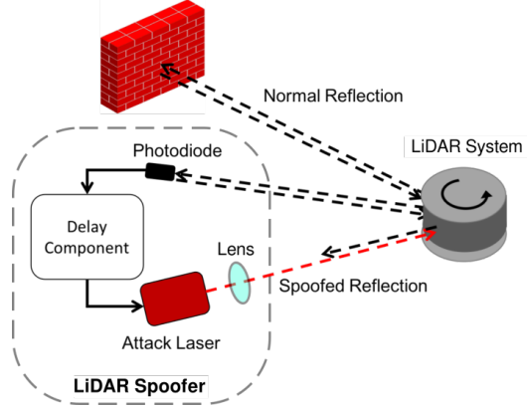
Laser Spoofing: Injecting Phantom Points
A photodiode detects the LiDAR's outgoing pulse, a delay component waits, and an attack laser fires a spoofed return
The delay sets the apparent range: points appear at a chosen distance, e.g., in the ego lane
The attacker does not break the sensor; it exploits that the sensor trusts any matching return
Naive attacks injected a few points; modern detectors discard them as noise (next slide)
Figure: Cao et al., USENIX Security 2023 (from the cited LiDAR attack slides). Shin et al., CHES 2017 for early LiDAR spoofing.
Notes:
Walk through the hardware loop in the figure. Emphasize that the spoofer is synchronized with the victim sensor. The follow-up slide explains why simply injecting points was not enough.

Slide 16
Naive Spoofing Is Not Enough (CCS 2019)
First security study of LiDAR-based perception in AD; blind spoofing is insufficient because the ML detector filters implausible points
Fix: optimization-based attack combined with global sampling to find point patterns the detector accepts as a vehicle: about 75 % success rate
Two real-world attack scenarios show impact on safety and mobility; defenses are proposed at AV-system, sensor and model levels
Left: clean synthetic scan; right: ≈ 70 injected points forming a phantom vehicle 8 m ahead (our illustration)
Cao et al., Adversarial Sensor Attack on LiDAR-based Perception in AD, CCS 2019. Original figure: synthetic scan.
Notes:
The original figure shows the optimized point pattern; ours is a schematic: 70 injected points forming a car-shaped cluster. Success rate is against the Baidu Apollo LiDAR perception model in the paper's setup; I quote the abstract-level number.

Slide 17
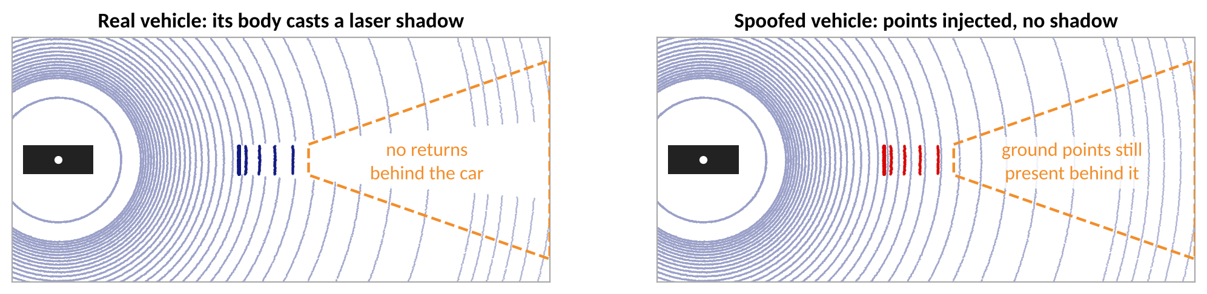
Black-Box Spoofing and the Occlusion Pattern
Sun et al. (USENIX Security 2020): perception models overlook occlusion patterns; a general black-box spoofing attack reaches ≈ 80 % mean success across target models
A real vehicle blocks the laser: no returns behind it. Spoofed points leave the space behind them populated
Defenses: CARLO (detect violations of the occlusion pattern) lowers success to ≈ 5.5 %; SVF (a robust architecture) to ≈ 2.3 %
Sun, Cao, Chen, Mao, Towards Robust LiDAR-based Perception in AD, USENIX Security 2020. Original figure: synthetic scene.
Notes:
Great example of a physics-based defense: use an invariant of the sensing process rather than adversarial training. The right panel shows our synthetic scene: ground points continue behind the spoofed vehicle. Caution: defenses were evaluated against the non-adaptive version of the attack in the paper's setting.

Slide 18
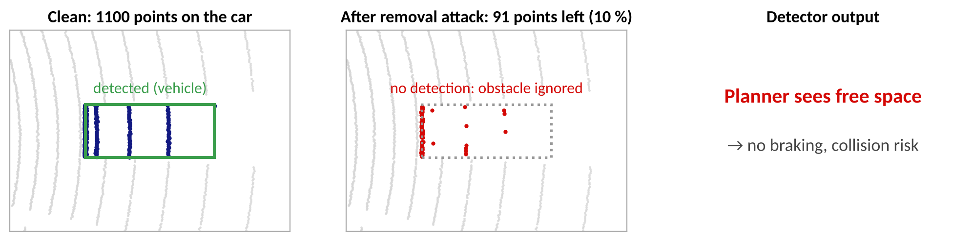
Removal Attacks: You Can't See Me
Cao et al. (USENIX Security 2023): physical removal attack eliminates point-cloud returns of a target at the sensor, before detection
92.7 % success removing 90 % of a target's points on moving vehicles, even at 45° angles; invisible to the human eye
Evaluated on Apollo, Autoware, PointPillars and three fusion models (Frustum-ConvNet, AVOD, Integrated-Semantic-Level Fusion)
Exploits sensor-level filtering and transformation, so a robust detector never sees the object
Cao et al., You Can't See Me, USENIX Security 2023. Original figure: synthetic scene, 90 % of the car's points removed.
Notes:
Our figure is schematic: we delete 90% of the points of a car in the synthetic scene. The key idea is that the attack acts before the neural network, so robustness of the network is not the relevant property.

Slide 19
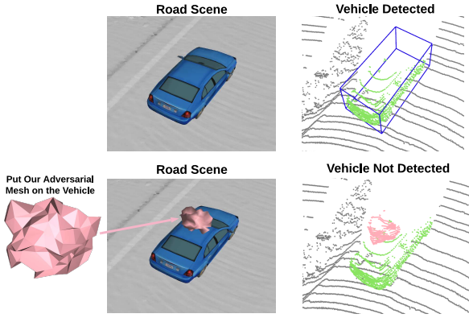
Adversarial Objects: Hiding a Car from LiDAR
Tu et al. (CVPR 2020): a universal 3D adversarial mesh placed on the roof of a vehicle hides it from LiDAR detectors
80 % success rate in hiding the vehicle
Tested against multiple detectors with different point-cloud representations; data augmentation was explored as a preliminary defense
A physical object, not a signal: no special hardware at attack time
Tu et al., Physically Realizable Adversarial Examples for LiDAR Object Detection, CVPR 2020. Figure from the paper (via course slides).
Notes:
Contrast with laser spoofing: here the attacker only needs to place an object. The figure shows the road scene with the mesh and the detection result with and without it.

Slide 20
Attacking LiDAR Segmentation (SenSys 2021)
First physically realizable attack on LiDAR point-cloud semantic segmentation
Two goals: vehicle hiding (parked car disappears) and road surface changing (road labeled as vegetation)
Adversarial objects: clusters of at most 10 points, up to 0.3 m, any shape that reflects LiDAR: cardboard, traffic signs, billboards
Models: PointNet, PointNet++, PointASNL, Cylinder3D, SqueezeSeg; data: SemanticKITTI plus real Ouster OS1-64 scans
Reported > 90 % success in real-world driving environments; robust to ≈ 0.3 m placement error (> 50 % effective)
Zhu et al., Adversarial Attacks against LiDAR Semantic Segmentation in AD, SenSys 2021; course slides (B. Johnson, UMM Seminar 2023).
Notes:
Point out how modest the physical requirement is: a handful of points. The success numbers come from the paper's setting (offline point clouds, attacker chooses object positions); they are not closed-loop results.

Slide 21
The Attack as an Optimization Problem
min over cluster positions s : L(s) = L_seg + α · L_sem + β · L_occ , α = 0.1, β = 1
L_seg
L_sem
L_occ
Segmentation loss: distance between the target labels and the predicted labels
Semantic loss: keep features of the unrelated scene unchanged (stealth)
Occlusion loss: prevent the object from being blocked, so the laser can hit it
• L3.2: variables = pixels in an ε-ball. Here: variables = where to put physical points; constraints come from sensing physics
• Gradients flow through a differentiable approximation of the voxelization / feature pipeline; Adam optimizer in the paper
Loss form as summarized from Zhu et al., SenSys 2021 (course seminar slides by B. Johnson, UMM, 2023).
Notes:
Compare with L3.2: there we maximized the loss over an epsilon-ball around the pixels. Here the variables are the positions of physical points, and the loss has three terms: a segmentation term (misclassify), a semantic term (keep the rest of the scene), and an occlusion term (the points must be visible to the sensor, otherwise the object is not physically useful). The weights alpha = 0.1 and beta = 1 are those reported in the seminar summary of the paper; they are hyperparameters.

Slide 22
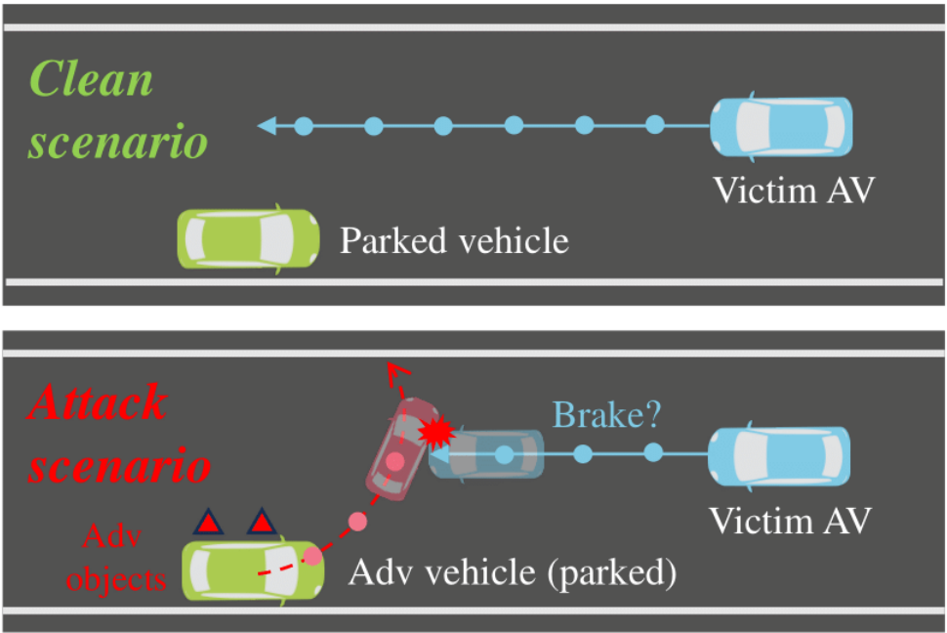
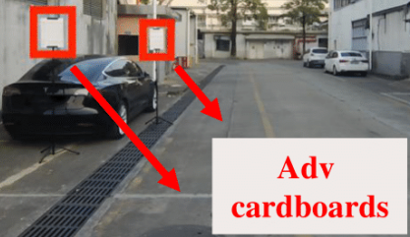
Beyond Detection: Fooling Trajectory Prediction
• Lou et al., USENIX Security 2024: LiDAR-induced deceptions cause a false predicted trajectory of a parked vehicle
• Adversarial objects (cardboards) trigger unsafe avoidance: unnecessary braking or lane change
Lou et al., A First Physical-World Trajectory Prediction Attack via LiDAR-induced Deceptions in AD, USENIX Security 2024. Figures via course slides.
Notes:
Move one stage down the stack. The attack does not hide anything; it adds adversarial objects (e.g., cardboards) near a parked vehicle so that the prediction module believes the parked car is about to move. The victim AV brakes or changes lane unnecessarily. This is a safety / comfort failure (level 3 in our ladder) caused by a perception-level manipulation.

Slide 23
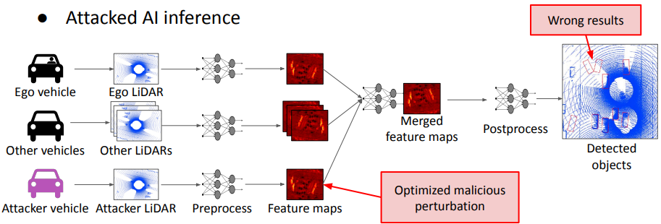
Collaborative Perception: Fabricated Features
Nearby vehicles share raw LiDAR or feature maps and fuse them: better perception in occluded scenes
New attack surface: a malicious vehicle fabricates data or features, and the fused output is corrupted
Zhang et al. (USENIX Security 2024) study attacks and countermeasures for data fabrication
Different from the ETSI Collective Perception Message, which shares object lists
Zhang et al., On Data Fabrication in Collaborative Vehicular Perception, USENIX Security 2024. Figure via course slides.
Notes:
Why this matters: cooperative perception moves the trust boundary from the sensor to the V2X link. The same idea returns in L3.4: CP-FREEZER attacks the latency of cooperative perception.

Slide 24
LiDAR Attacks at a Glance
Attack (venue) | Channel | Target | Reported result (own setup)
Cao et al. (CCS 2019) | laser spoofing | Apollo LiDAR perception | ≈ 75 % success
Sun et al. (USENIX Sec 2020) | laser spoofing, black-box | multiple LiDAR detectors | ≈ 80 % mean success
Cao et al. (USENIX Sec 2023) | laser removal | Apollo, Autoware, PointPillars, fusion | 92.7 % remove 90 % of points
Tu et al. (CVPR 2020) | adversarial object (roof) | LiDAR 3D detectors | 80 % hide the vehicle
Zhu et al. (SenSys 2021) | adversarial objects | segmentation networks | > 90 % in real-world tests
Lou et al. (USENIX Sec 2024) | adversarial objects | trajectory prediction | false trajectory → unsafe avoidance
Zhang et al. (USENIX Sec 2024) | V2X feature fabrication | collaborative perception | corrupted fused detections
Numbers as reported in the cited abstracts; setups differ and are not directly comparable.
Notes:
Summary table for review. Emphasize the footnote: each number is measured in the authors' own threat model and metric, so the rows are not directly comparable.

Slide 25
Outline
Recap and the AD attack surface
Attacks on object tracking
Attacks on LiDAR perception
Is sensor fusion safe?
From perception errors to driving consequences
Defenses and discussion
Notes:
Part 4: sensor fusion (about 10 minutes). Central question: does adding a second sensor make the system safe?

Slide 26
Camera-LiDAR Fusion: Why It Looked Robust
Camera image
2D detector
(frustum / proposals)
Fusion
(consistency)
3D boxes
LiDAR points
3D features
Fusion
(consistency)
3D boxes
• Assumption: an attacker must fool both sensors consistently to change the output
• Naive LiDAR spoofing: injected points have no camera evidence, so fusion discards them
• Fusion pipelines use cross-modal checks: semantic agreement, geometric agreement (frustum)
• Question: can an attacker who knows these checks satisfy them?
Schematic fusion architectures; Hallyburton et al., USENIX Security 2022.
Notes:
Fusion architectures differ (early, feature-level, late). The shared intuition is redundancy: to attack the system you must fool both modalities consistently. Hallyburton et al. showed that traditional LiDAR spoofing cannot disrupt camera-LiDAR fusion; the open question was whether an attacker who understands the fusion can.

Slide 27
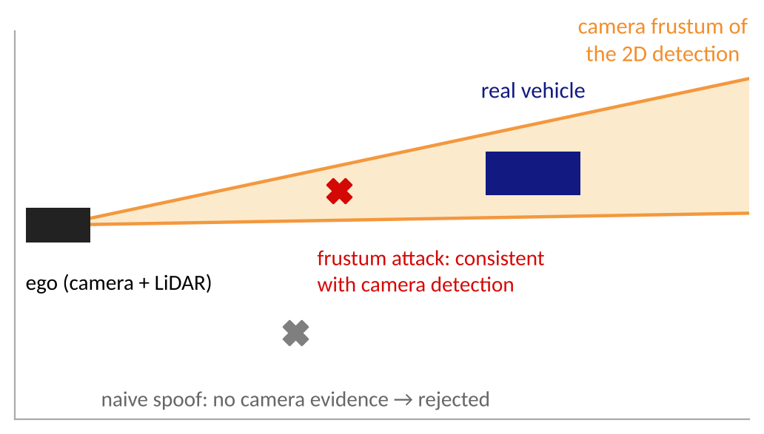
The Frustum Attack (USENIX Security 2022)
Hallyburton et al.: black-box attack that spoofs LiDAR points inside the camera frustum of an object
It preserves consistency between camera and LiDAR semantics, so existing LiDAR-spoofing defenses do not fire
Succeeds against 8 perception algorithms: 3 LiDAR-only and 3 camera-LiDAR fusion architectures
Repeated over time it forms longitudinal attack sequences that compromise tracking and end-to-end AV control
Hallyburton et al., Security Analysis of Camera-LiDAR Fusion Against Black-Box Attacks on AVs, USENIX Security 2022. Original schematic.
Notes:
The figure is a schematic of the idea (top view): the real vehicle defines a camera frustum; a naive spoof outside it has no camera support, but a spoof inside it agrees with the camera. The paper reports qualitative vulnerability across all tested algorithms; I do not quote a single success rate.

Slide 28
MSF-ADV: Invisible to Camera and LiDAR
Cao et al. (IEEE S&P 2021): first study of multi-sensor-fusion perception under physical-world attack
A 3D-printed adversarial object that makes the AD system fail to detect it: invisible to camera and LiDAR
Over 90 % success across object types and MSF configurations; 100 % collision rate in simulation against industry-grade systems
Technical challenges solved: non-differentiable camera and LiDAR sensing, and cell-level aggregated features in LiDAR perception
Transfers across MSF algorithms
Cao et al., Invisible for both Camera and LiDAR, IEEE S&P 2021.
Notes:
Different strategy from the frustum attack: instead of exploiting the consistency check, the attacker optimizes one physical object against both branches at once. Note the closed-loop (simulation) evidence.

Slide 29
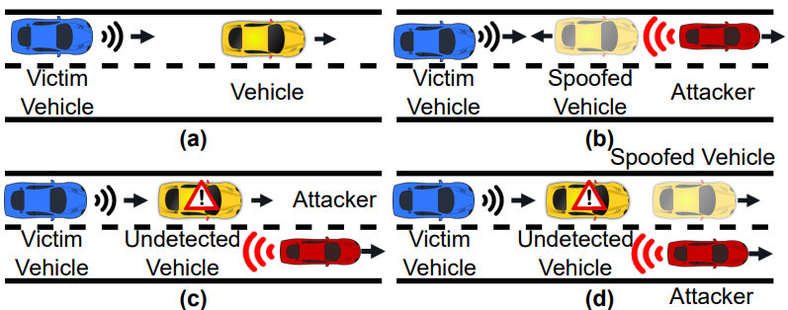
Does More Sensors Mean More Safety?
Yes against independent, random failures: redundancy helps
Not automatically against an attacker who understands the fusion logic: frustum attack and MSF-ADV
Independent physics helps but is not immune: radar can also be attacked to add, remove or move objects (MadRadar)
Design rule: evaluate fusion against cross-modal adaptive attacks, and use sensors whose failure modes are truly independent
Hunt et al., MadRadar, NDSS 2024 (figure via course slides); Hallyburton et al. 2022; Cao et al. 2021.
Notes:
Discussion prompt: what would a fusion design look like that stays safe if one modality is fully adversarial? (e.g., conservative disagreement handling, diversity, anomaly detection per modality.) Radar figure from the MadRadar paper: add, remove, move.

Slide 30
Outline
Recap and the AD attack surface
Attacks on object tracking
Attacks on LiDAR perception
Is sensor fusion safe?
From perception errors to driving consequences
Defenses and discussion
Notes:
Part 5: from perception errors to driving consequences (about 15 minutes). We now measure harm at the controller.

Slide 31
Dirty Road Patch: Attacking Lane Centering
Camera
Lane-detection
DNN
Lane-center
estimate
Lateral
controller
Steering
the patch attacks this stage
• Sato et al., USENIX Security 2021: first systematic study of DL-based automated lane centering under physical-world attack
• Attack vector: a dirty road patch that resembles an ordinary road stain, placed on the lane
• Optimization-based design; domain-specific challenges: camera-frame dependence (the patch moves in the image as the car drives) and the lane-detection objective
• The harm is defined on the vehicle's lateral deviation, not on a classification label
Sato, Shen, Wang, Jia, Lin, Chen, Dirty Road Can Attack, USENIX Security 2021.
Notes:
Automated lane centering (ALC) is a deployed driver-assistance feature: a lane-detection network estimates the lane center and a lateral controller steers to it. The attacker places a patch on the road that looks like an ordinary stain. The paper's challenges: camera frames change as the car moves (the patch appears at different pixel locations), and the attack objective must be defined on the lane-detection output, not on a class label.

Slide 32
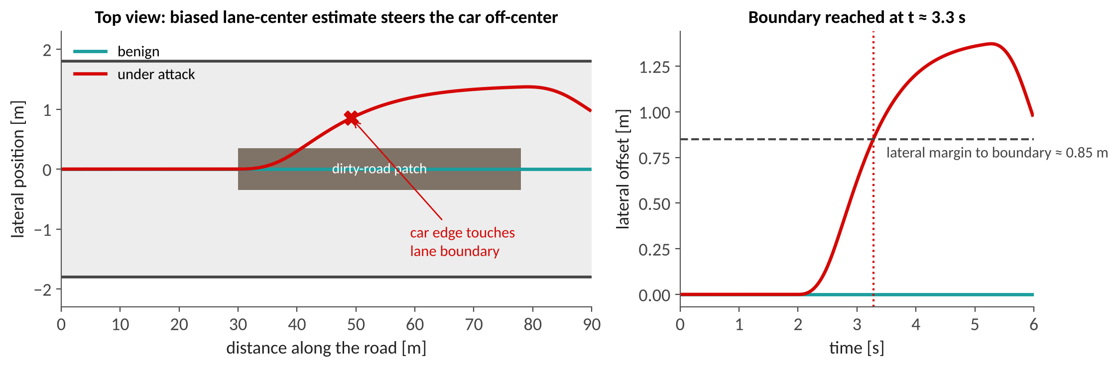
Why a Small Bias Can Steer a Car
Toy model: 15 m/s, lane half-width 1.8 m, car half-width 0.95 m ⇒ lateral margin ≈ 0.85 m; the patch biases the perceived lane center by 1.4 m
The controller faithfully tracks the wrong center: the car crosses the boundary after ≈ 3 s, while the benign run stays centered
Lesson: define the attack objective on control error, and evaluate with a vehicle model in the loop
Original figure: toy lateral-control simulation (illustrative; not data from Sato et al.).
Notes:
This is our illustration with made-up parameters (not the paper's numbers): a critically damped lateral controller follows the biased lane-center estimate. The point is the mapping from a perception bias to a physical boundary crossing, which a classification metric cannot express.

Slide 33
Dirty Road Patch: Results
> 97.5 %
< 0.9 s
100 %
80
attack success rate
average time to success
(0.903 s)
collision rate in
software-in-the-loop + real vehicle
scenarios from real
driving traces
Robust
Across lighting conditions, view angles and model designs; still effective with automatic emergency braking on; visually inconspicuous to drivers
Discussion
Success time is shorter than typical driver reaction time. What should a safe system do when the lane estimate and the map disagree?
Sato et al., USENIX Security 2021.
Notes:
Level 3 evidence: simulation and a real vehicle. 0.903 s is the average time until the attack succeeds and is below typical driver reaction times, which is why a human supervisor is not a reliable fallback. The authors also report the attack remains effective with automatic emergency braking enabled.

Slide 34
Adversarial Driving Maneuvers: Acero
Song, Ozmen, Kim, Muller, Celik, Bianchi (Purdue): attack the AV with normal-looking driving, not with pixels or lasers
Threat model: an attacker vehicle performs realistic maneuvers; nothing is modified in the environment
Goal: force the victim AV to violate safety rules and cause physical consequences (collision with vehicles, pedestrians, objects)
Formalizes 7 safety requirements and 7 physical constraints (the attacker must not endanger itself or break traffic laws)
Targets the planning / control layers; perception defenses do not help
Song et al., Discovering Adversarial Driving Maneuvers against Autonomous Vehicles, USENIX Security 2023.
Notes:
Conceptual pivot: the attack surface is the behavior of other road users. Because the maneuvers are legal and plausible, detection of 'adversarial' input is meaningless; the system must be safe against all plausible behavior.

Slide 35
Acero: Robustness-Guided Fuzzing
Maneuver
parameters
Simulate victim AV
(OpenPilot / Autoware)
Safety-spec
robustness
Guide mutation
(fuzzing)
Successful
attacks
repeat: lower robustness = closer to violation
• Safety rules (e.g., time-to-collision, staying in lane) are written as temporal-logic specifications with a quantitative robustness value
• Physical constraints keep the attacker legal and safe: the search space is realistic driving, not arbitrary trajectories
• Trajectory-similarity clustering groups successful attacks into distinct root causes
• Same idea as software fuzzing, with a physical, closed-loop oracle
Song et al., USENIX Security 2023 (framework summary).
Notes:
Explain the loop. A maneuver is parameterized (when to cut in, how hard to brake, ...). A simulator runs the victim AV. A robustness value says how close the run came to violating each safety specification (temporal logic), and the fuzzer mutates maneuvers toward lower robustness. Successful attacks are clustered by trajectory similarity so engineers can find root causes rather than thousands of individual runs.

Slide 36
Acero: Results
219
122
73.3 %
attacks found
OpenPilot
attacks found
Autoware
of attacks end in a collision
(vehicles, pedestrians, objects)
Takeaway
No pixel, point or signal was modified. Perception-focused defenses (adversarial training, sensor checks) are irrelevant to this attack.
Caveat
Results are from simulation against specific AD software; they describe the failure category rather than a real-world rate.
Song et al., USENIX Security 2023.
Notes:
Numbers from the USENIX page. 73.3% of the discovered attacks resulted in collisions with third-party vehicles, pedestrians, or static objects. Discuss: these are simulation results against specific software versions; they show the category of failure, not a rate per mile driven.

Slide 37
What Each Paper Demonstrated
Paper | How it reaches the vehicle | Strongest evidence reported
Ma et al., tracking (VehicleSec 2023, WIP) | dynamic patch on monitor / projector | Level 1-2: tracking errors, 90 % / 80 % (preliminary)
Cao et al., spoofing (CCS 2019) | laser spoofing | Level 1 (≈ 75 %) plus two real-world scenarios
Sun et al. (USENIX Sec 2020); Cao et al. (USENIX Sec 2023) | laser spoofing; laser removal | Level 1 (≈ 80 %; 92.7 %)
Tu et al. (CVPR 2020); Zhu et al. (SenSys 2021) | adversarial objects | Level 1 (80 %; > 90 %)
Hallyburton et al., frustum (USENIX Sec 2022) | laser spoofing in camera frustum | Level 1-3: tracking and end-to-end control outcomes
Cao et al., MSF-ADV (S&P 2021) | 3D-printed object | Level 3: 100 % collision in simulation
Sato et al., dirty road (USENIX Sec 2021) | road patch | Level 3: simulation + real vehicle, 100 % collision
Song et al., Acero (USENIX Sec 2023) | driving maneuvers | Level 3: 73.3 % of attacks end in a collision
Levels assigned from the abstracts and talk slides of the cited papers; check each paper for details.
Notes:
Close the technical content with the ladder from slide 6. Ask students which row they would trust most for a safety argument and why. Levels are my reading of the abstracts / slides; students should check the papers before citing.

Slide 38
Outline
Recap and the AD attack surface
Attacks on object tracking
Attacks on LiDAR perception
Is sensor fusion safe?
From perception errors to driving consequences
Defenses and discussion
Notes:
Part 6: defenses and discussion (about 8 minutes).

Slide 39
Defending AD Perception: A Layered View
Layer | Defense idea | Example from this lecture | Limitation
Sensor | harden the sensing process (e.g., timing randomization, filtering) | countermeasures proposed with spoofing / removal attacks | hardware changes; adaptive attackers
Model | adversarial training, augmentation, robust architectures | SVF (≈ 2.3 % success); augmentation vs. adversarial objects | attack-specific; costs accuracy and latency
Physical consistency | check invariants of sensing physics | CARLO: occlusion pattern (≈ 5.5 % success) | bypassed if the attacker models the check (frustum attack)
Cross-sensor / temporal | compare modalities and frames | camera-LiDAR consistency; track plausibility | defeated by consistent attacks; need diverse sensors
System | safe fallback, monitors at planning, adversarial testing | fuzzing of planners (Acero) to find unsafe behaviors | needs formal safety rules and simulation coverage
Defense numbers from Sun et al., USENIX Security 2020; layering by the instructor.
Notes:
Defenses should be layered because each layer has blind spots. Emphasize that numbers like 5.5% and 2.3% were measured against the attack as published; adaptive attackers are the real test.

Slide 40
Evaluating Attacks and Defenses Honestly
Question to ask of an attack paper | Why it matters
What is the threat model (channel, knowledge, cost)? | A laser spoofer and a cardboard box are very different threats
Is it physically realized, or digital only? | Digital success rarely transfers: viewpoint, lighting, sensor noise
What is measured: per frame, per sequence, or closed-loop? | Level 1 success does not imply level 3 harm (tracking, controller)
Which stack and version? | Results on Apollo / Autoware / OpenPilot depend on versions and configuration
Is the defense evaluated against an adaptive attacker? | Non-adaptive evaluation overstates robustness
Are the claims preliminary (WIP)? | Quote success rates with their limits, not as universal risk
Instructor's checklist.
Notes:
Use as a checklist for the paper-reading assignment. Each row can be answered from the papers in the reading list.

Slide 41
Discussion Questions
Camera-only vs. LiDAR + camera + radar: which is easier to attack, and what does 'easier' mean (cost, access, stealth)?
A one-frame detection failure: is it a safety problem? When does it become one (tracking, controller, fallback)?
Design a defense for removal attacks that acts before the neural network. What does it cost?
Acero finds attacks with legal driving. Who is responsible: the attacker, the AV maker, or the regulator?
Pick one paper from the reading list and place it on the three-level ladder; what evidence is missing for the next level?
Notes:
Allow about 8 minutes: pairs for 3 minutes, then two or three groups report.

Slide 42
Next Lecture and Further Reading
L3.4: not only wrong outputs but late outputs: latency and availability attacks on AD perception, tracking, and VLMs
Curated list of AD security papers (attacks and defenses): github.com/ideasplus/Awesome-Autonomous-Driving-Security
USENIX talk pages: Hallyburton et al. 2022 (usenixsecurity22/presentation/hallyburton); Sato et al. 2021 (usenixsecurity21/presentation/sato); Song et al. 2023 (usenixsecurity23/presentation/song)
Project pages: sites.google.com/view/secure-safe-ai/drp-attack (Dirty Road); cpsl.pratt.duke.edu/research/frustum-attack
Foundations: adversarial-ml-tutorial.org (Kolter and Madry, NeurIPS 2018)
Notes:
Assignment idea: choose one paper above, fill the checklist from the 'Evaluating attacks honestly' slide, and place it on the three-level ladder.

Slide 43
References
Cao et al., Adversarial Sensor Attack on LiDAR-based Perception in Autonomous Driving, CCS 2019
Cao et al., Invisible for both Camera and LiDAR (MSF-ADV), IEEE S&P 2021; Cao et al., You Can't See Me, USENIX Security 2023
Hallyburton et al., Security Analysis of Camera-LiDAR Fusion Against Black-Box Attacks, USENIX Security 2022
Hunt et al., MadRadar, NDSS 2024; Jia et al., Fooling Detection Alone is Not Enough, ICLR 2020
Lou et al., A First Physical-World Trajectory Prediction Attack via LiDAR-induced Deceptions, USENIX Security 2024
Ma, Wang, Chen, Shen, Towards the Practicality of the Adversarial Attack on Object Tracking in AD, VehicleSec 2023 (WIP)
Sato et al., Dirty Road Can Attack, USENIX Security 2021; Song et al., Discovering Adversarial Driving Maneuvers, USENIX Security 2023
Sun et al., Towards Robust LiDAR-based Perception in Autonomous Driving, USENIX Security 2020
Tu et al., Physically Realizable Adversarial Examples for LiDAR Object Detection, CVPR 2020
Zhang et al., On Data Fabrication in Collaborative Vehicular Perception, USENIX Security 2024
Zhu et al., Adversarial Attacks against LiDAR Semantic Segmentation in Autonomous Driving, SenSys 2021
Notes:
Full references for the lecture.

